Slide 1

RAVEN: Overview
A. Alfonsi, C.Rabiti, P. Talbot, D. Mandelli, C. Wang, J. Cogliati, M. Abdo
RAVEN WORKSHOP

Slide 2
Outline
RAVEN modules
General Code structure
UQ and PRA capability needs
Modeling needs
Why, Where and Who?
Background
RAVEN Overview
Samplers
Forward Sampling
Dynamic Event Tree
Adaptive Sampling
Statistical analysis of large and complex data sets
Transient analysis
Clustering
Data analysis
Models
Codes
Surrogate Models
Artificial Intelligence-guided modeling

Slide 3
Project Background
RAVEN development has begun in early 2012. Been supported by:
Light Water Reactor Sustainability (LWRS), under the RISMC path-way (Risk-Informed Safety Analysis - RISA)
Nuclear Energy Advanced Modeling and Simulation Program (NEAMS)
Nuclear-Renewable Hybrid Energy Systems (NHES)
The overall goal was to conceive a tool to enable Risk Informed Safety Margin Characterization (RISMC)
Evaluating risk (uncertainty propagation)
Understanding risk (limit surface, ranking, sensitivity, data mining)
Mitigating risk (optimization)

Slide 4
RAVEN Accessibility and Software practices
RAVEN is open-source and can be downloaded from GITHUB:
https://github.com/idaholab/raven
Multiple operative systems are supported (and automatically tested):
Windows: 7, 8, 8.1, 10
Linux: Ubuntu, Fedora, CentOS, OpenSUSE
Macintosh: Yosemite, El Capitan, Sierra, High Sierra, Mojave
RAVEN development is performed under a strict Software Quality Assurance process:
NQ1 – Lvl. 2
User manuals and guides, theory manuals, tests documentation
Multiple level of peer-review process
Automatic verification (testing) (~650 regression tests)
Code coverage (>80%)
An assessment to bring RAVEN to NQ1– Lvl. 1 is under discussion

Slide 5

Team
D. Mandelli
(Main Developer)
A. Alfonsi
(Technical Leader)
J. Cogliati
(Main Developer)
C. Rabiti
(Project Manager)
C. Wang
(Main Developer)
P. Talbot
(Main Developer)
M. Abdo
(New Developer)
A. Epiney
(Assessor)
C. Parisi
(Assessor)
RAVEN TEAM
5

Slide 6
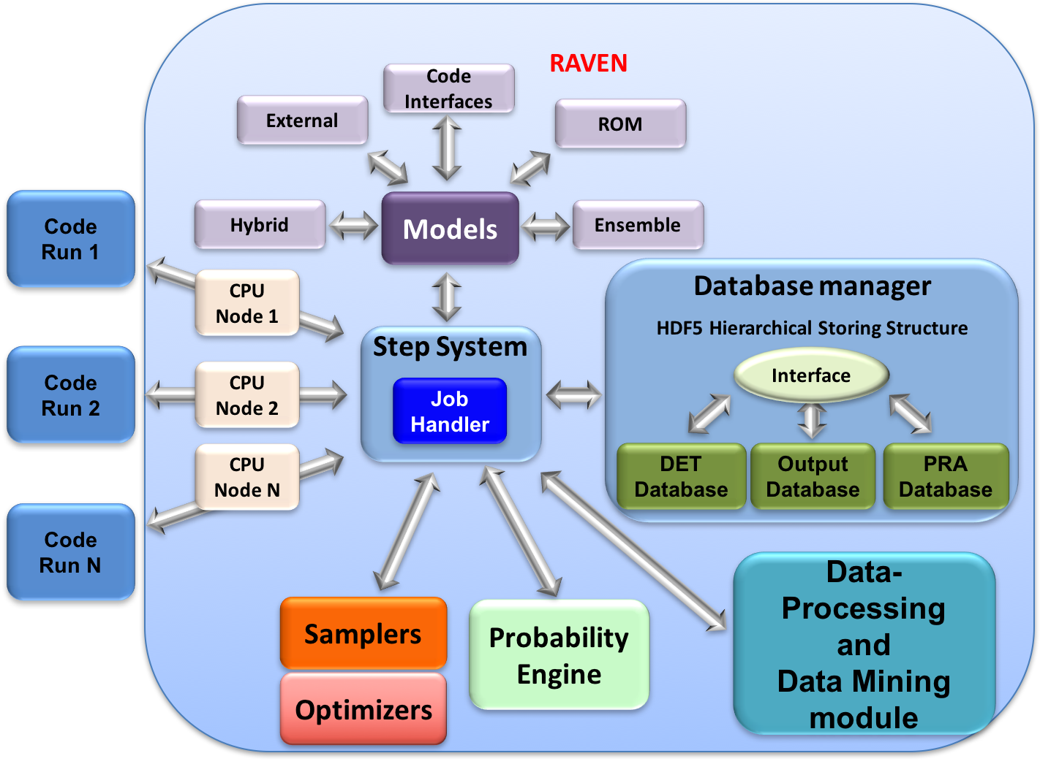
RAVEN Infrastructure
https://github.com/idaholab/raven
raven.inl.gov

Slide 7
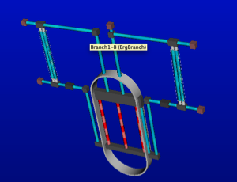
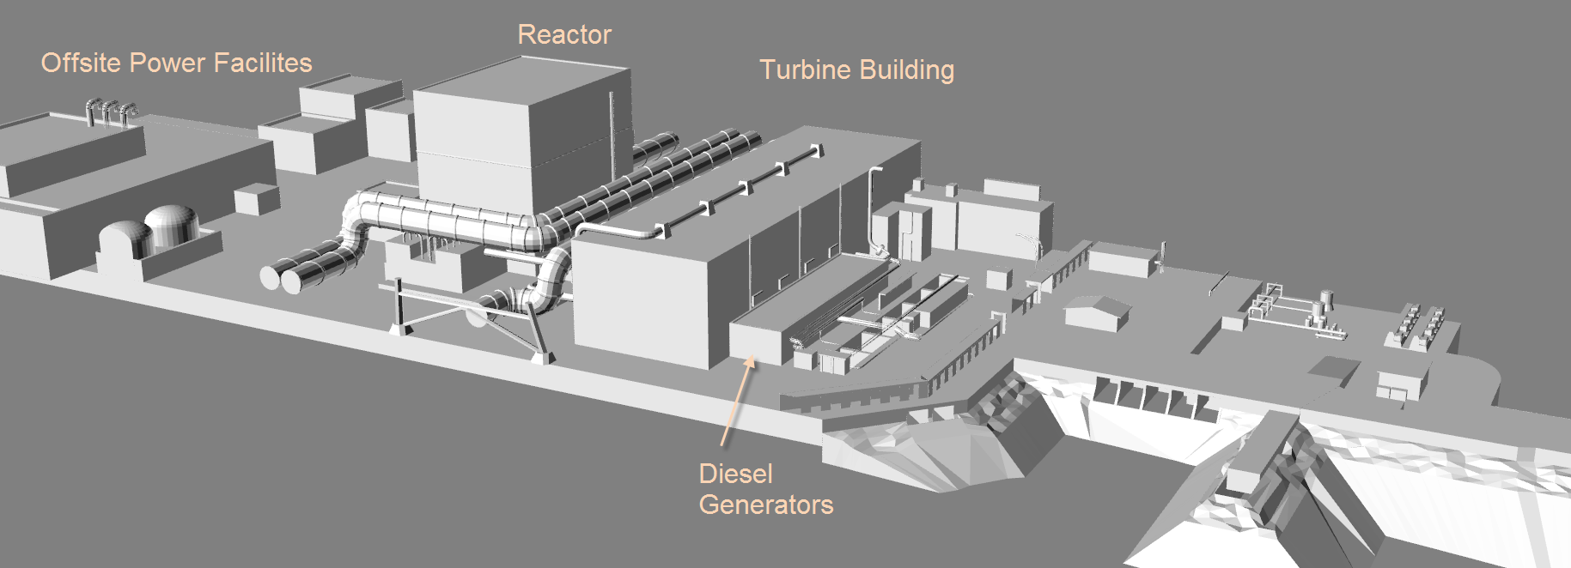
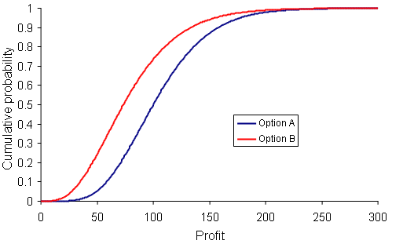
Dynamic Probabilistic Risk/Safety Analysis
Stochastic analysis
Sample the pdfs
Run N times system simulation code(s)
Evaluate desired FOMs
Deterministic modeling
Plant modeling
External event modeling
Stochastic modeling
Identify uncertain parameters and associate a pdf

Slide 8
UQ and PRA: Capabilities vs. Needs
Distributions
Stochastic Modeling
Uncertainty Quantification
Sampling
Model Perturbation
Surrogate Models
Convergence/Analysis acceleration
Statistical analysis
Probabilistic Risk Assessment
Uncertainty Assessment
Data Analysis
Driver analysis
Reliability Analysis
Risk assessment and Probability estimation

Slide 9
Probability Density Functions
1-Dimensional Probability Density Functions
N-Dimensional Probability Density Functions
Import from file for custom N-dimensional distributions:
N-dimensional splines on Cartesian grids
Inverse weight interpolation
Sampling of N-dimensional distributions by unbiased inversion
PDF | Truncated | PDF | Truncated
Bernoulli | No | Poisson | No
Binomial | No | Triangular | Yes
Exponential | Yes | Uniform | Yes
Normal | Yes | Weibull | Yes
LogNormal | Yes | Gamma | Yes
Logistic | Yes | Beta | Yes
Categorical | Yes | Laplace | Yes
Geometrical | Yes | Custom | Yes

Slide 10
Samplers (Forward)
RAVEN supports many forward samplers
Monte Carlo
Grids:
equal-spaced in probability and/or in value or custom
mixed (probability, custom, value)
Stratified (LHS type)
equal-spaced in probability and/or in value or custom
mixed (probability, custom, value)
Factorial Designs:
2-Level Fractional-Factorial
Plackett-Burman
Response Surface Designs:
Box-Behnken
Central Composite
Generalized stochastic collocation polynomial chaos
A different sampling strategies can be associated to each variable separately

Slide 11
Dynamic Event Trees (DET)
Sampling is decided beforehand for “control variables”
the corresponding simulation is run only if the physics triggers the control variable
DET can be used in a mixed fashion with any of the other sampler
PDF
Pressure
Time
Stochastic system could not be fully controlled by the initial condition
Pipe failure pressure
Failure @66% CDF
Cumulative Distribution Function (CDF)
Failure @33% CDF
Pressure
Pressure
Time
Pipe failure pressure
DET available with RELAP5-3D, MAAP, RELAP-7
Time

Slide 12
Reliability Surfaces
Trying to avoid high temperature regions
High Risk Direction
Excessive Temperature Region
Risk Neutral Direction

Slide 13
Limit Surface (Reliability Surface) Search
Algorithm for LSS
Reduce the complexity of the problem
Set of equations are trained to approximate the original model
Computationally faster
Use of ROM for predicting where further input space exploration is more informative
Use new info for updating ROM (iterative process)
Algorithm steps:
Training ROM using high-fidelity code (e.g. RELAP5-3D) on initial low number of sampled points
A fine grid (failure/success points) is generated using the trained ROM
LS is identified by the location of transition between failure/success
A new point (the farthest point from any other point already tested) is chosen → re run the high-fidelity code to increase the training set
Convergence test: the predicted LS does not change from an iteration and the other (persistence)
Process starts back from point 2 until the limit surface does not change anymore
FAILURE
Limit Surface
SUCCESS
Next point

Slide 14
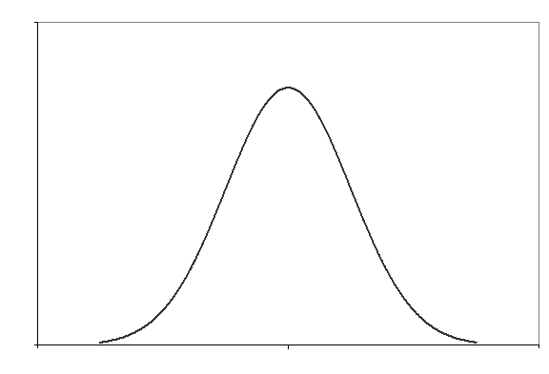

Failure Probability Calculation From LS
Limit surface has a pure deterministic information
Probabilistic information is contained in the integral within the limit surface weighted by the set of distributions
For a new set of distributions the integral needs to be recalculated but the limit surface is unchanged
Ω

Slide 15
Optimization
(X_{n},Y_{n})
Try to fit straight line to a set of points (X_{i}, Y_{i})
Define target function to minimize
For example least squares
Minimize with algorithm
Find “a” and “b” such that T(a,b) is minimal
For example “gradient descent” algorithm
move in direction
What if lots of decision variables (T=T(a,b,c, …)) or system is stochastic (X_{i} Y_{i} not unique)? may be difficult or impossible to evaluate
Stochastic optimization algorithms
Y = aX+b
(X₁,Y₁)

Slide 16
Simultaneous Perturbation Stochastic Approximation (SPSA) Optimizer
No gradient formula or gradient measurements needed
Approximate the gradient based on two function evaluations
Simultaneously approximate gradient for all variables
Regardless of the number of decision variables
Converge to optimal in stochastic sense
Inaccurate estimation of gradient may temporarily lead to worse solution
There has been a growing interest in stochastic optimization algorithms that do not depend on direct gradient information or measurements
Applicable in areas such as statistical parameter estimation, (nonlinear) feedback control, simulation-based optimization, signal and image processing, and experimental design
Notes:
Typical optimization algorithms require reliable information knowledge of the system input-output relationships, implying that the gradient-based algorithms may be either infeasible (if no system model is available) or undependable (if a poorer system model is used).
Noisy input information may result in a loss function value that does not improve as the iteration process proceeds.

Slide 17
Models
RAVEN categorizes in its Models entity the following sub-entities:
Codes:
Aimed to interface with physical codes (e.g. RELAP5-3D, etc.)
ROMs:
Aimed to emulate the response of a system based on a simplified mathematical representation
External Models:
Aimed to provide to the user an easy way to implement sets of equations directly in RAVEN
Post-Processors:
Aimed to analyze the generated datasets (e.g. Statistical moments, Data Mining, etc.)
Ensemble Models:
Aimed to assemble multiple models (of any type)
Hybrid Models:
Automatic model selections (Surrogate and “high-fidelity” models)

Slide 18
Codes
RAVEN currently coupled with:
RELAP5-3D/ RELAP5 mod 3
MELCOR
MAAP5
MOOSE-BASED APPs
SCALE
SERPENT
PHISICS
COBRA TF
SAPHIRE
MODELICA
DAYMOLA
BISON
MAMMOTH
GOTHIC
External Code
Structured text input file?
Create Code Interface (Input)
no
yes
No need to create interface: Generic Code
yes
CSV output?
CSV output?
Create an output parser
no
no
yes
Inherit from GenericCode and create an output parser
No need to create an output parser: RAVEN reads CSVs

Slide 19
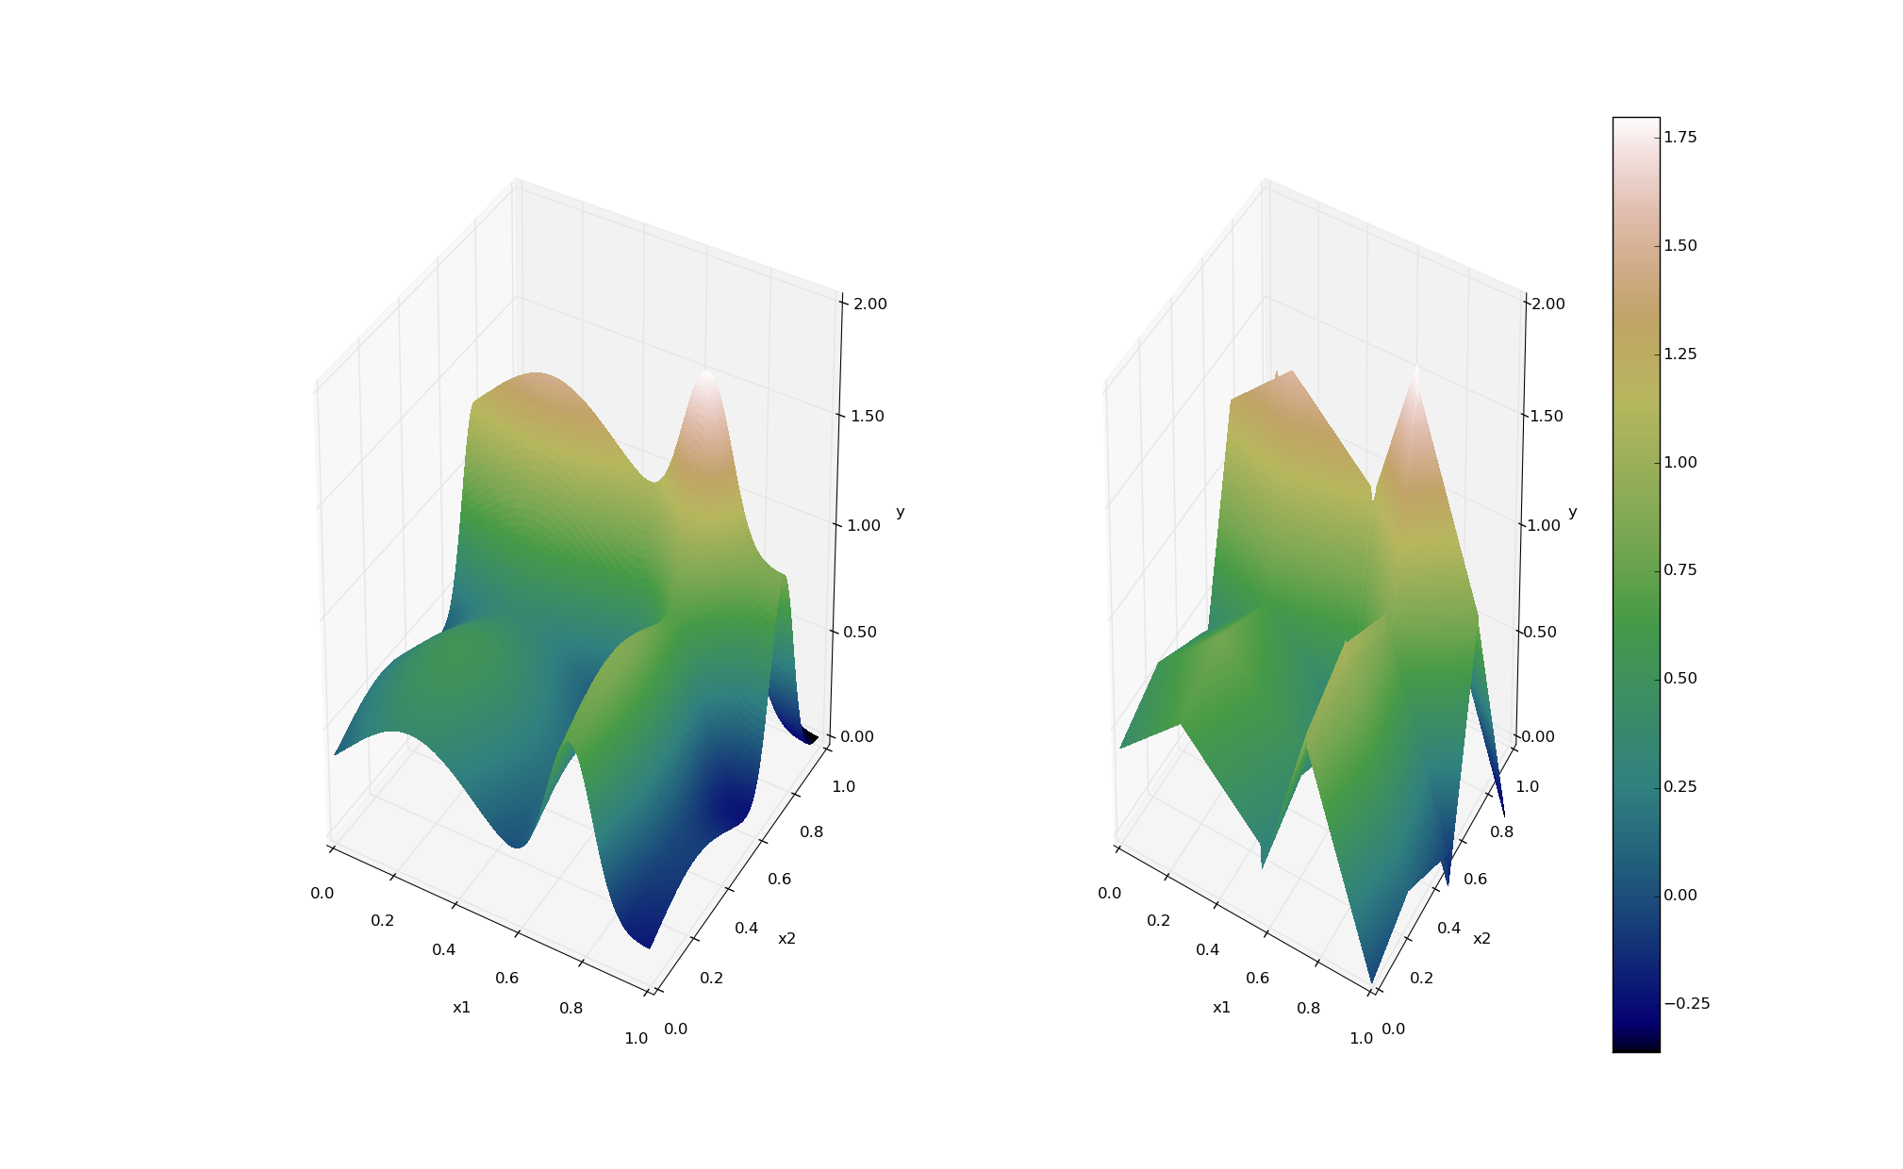
ROMs: a Quick Introduction
Output: Simulation outcome (success/failure, max clad temperature)
Consider a set of N data points
Build a surrogate model
Reduced Order Model
Data
Inputs: Initial and boundary conditions
≅

Slide 20
Cross-Validation for assessing ROMs validity
Take out some of the training set
Train on the remaining training set
Test on the excluded instances
Cross-validation
Cross Validation
Compute a score (e.g. R²)
Dataset
Train
Test

Slide 21
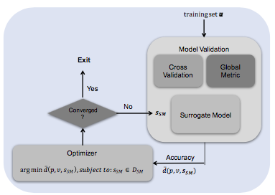
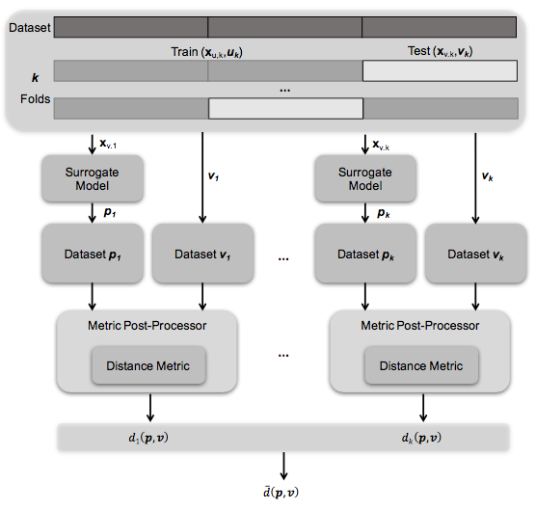
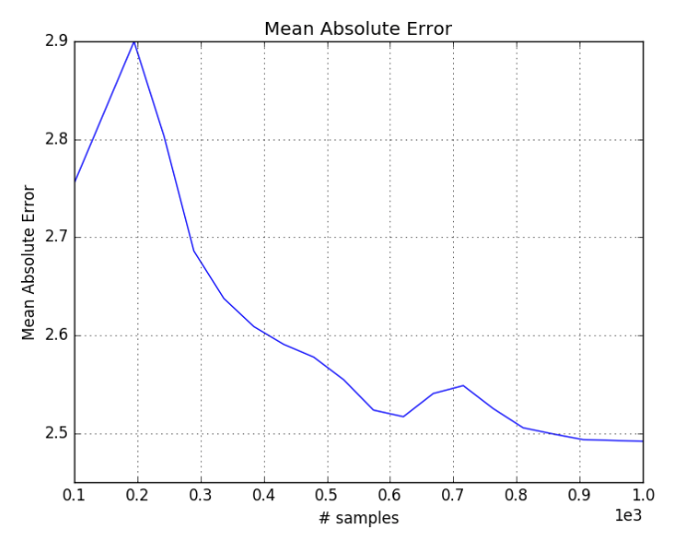
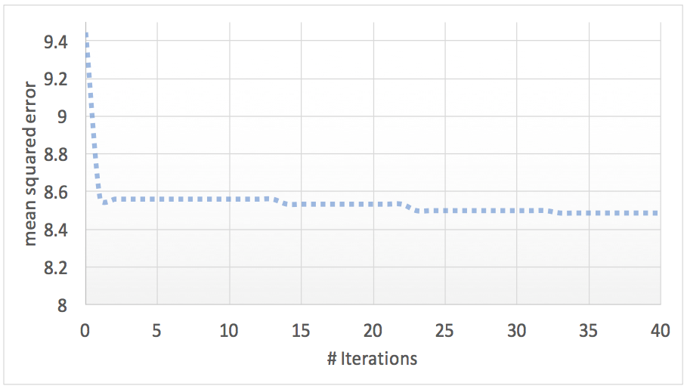
Surrogate Models’ assessment and optimization
Surrogate Model Parameter Optimization
Cross-validation techniques for the global assessment of surrogate models
Mean Absolute Error score (Cross-validation) as function of # samples
Optimization of SM parameters example

Slide 22
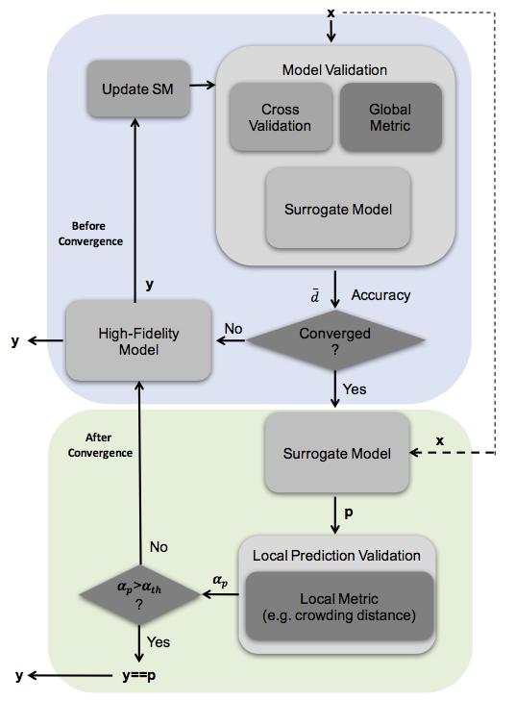
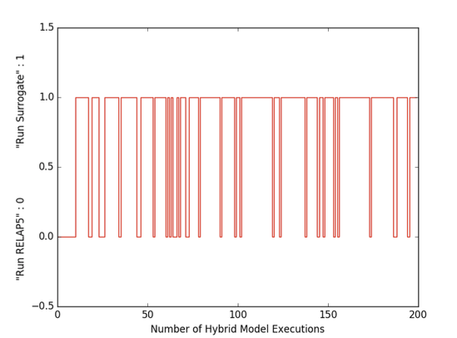
Hybrid-Model (automatic selection ROM/physical model)
Example of automatic selection for 200 MC samples on a PWR SBO sequence using RELAP5-3D and SVM surrogates
When the HybridModel is used, of the 1000 Monte Carlo samples, only 200 were run using the RELAP5-3D model, resulting in a computational time reduction of 800*4 = 3200 CPU-hrs
Adaptive surrogate modeling scheme

Slide 23
Available ROMs
Nearest neighbor (KD-Tree based)
Support vector machine:
Polynomial kernel
Gaussian Kernels
Radial basis functions
Inverse Weight
N-Dimensional spline
Gaussian process
Polynomial (stochastic and not)
Linear regressors
Neural Networks (deep learning)
Many more (see RAVEN documentation)

Slide 24
Ensemble model
Multiple “models” can be assembled together and treated as a single one
Models can be completely heterogeneous (code, external models, ROM)
RAVEN acts as a hub for the information exchange
Information passed between “models” could be:
Set of lump values
Set of time series or fields
Model N-1
Model 1
Model N
Notes:
Sometimes, multiple models need to interface with each other since the initial conditions of some are dependent on the outcomes of others

Slide 25
Statistical Post Processing
Statistical characterization of the output (uncertainty propagation)
Mean
Sigma
Skewness (asymmetry)
Kurtosis (more/less peaked than a standard normal)
Input/output relationship (ranking/sensitivity)
Correlation matrix
Covariance matrix
Sensitivity matrix (multidimensional linear regression)
Normalized sensitivity matrix (% change of the response / % change in the answer)

Slide 26
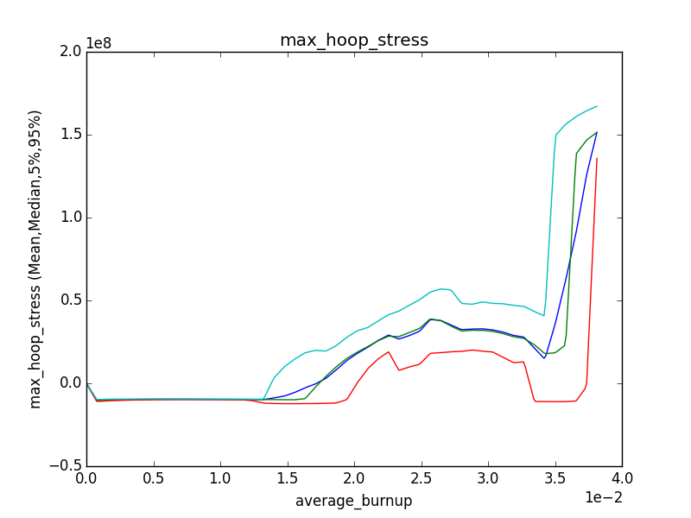
Time Dependent Statistics: Fuel Performance
95% percentile
Mean
Median
5% percentile
Max hoop stress during transient as a function of burn up

Slide 27
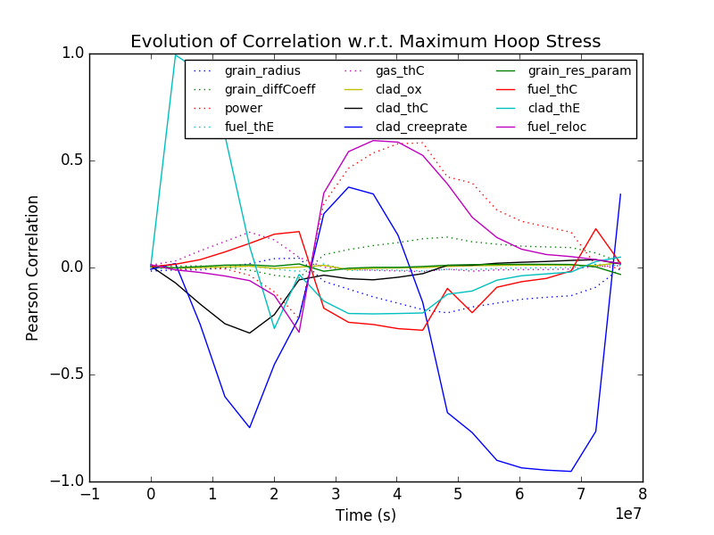
Time Dependent Relational Analysis
The correlation analysis reveals how much each input is linearly related to the input space
Changes in the correlation coefficient usually indicate a change in the dominating physics

Slide 28
Validation Metrics
Probability Distribution Function Area Metric
Distance Probability Distribution Function
Minkowski L₁ Metric

Slide 29
Data Mining
RAVEN gives access to several data mining algorithms for data post-processing via implementation of APIs between RAVEN and Scikit-learn and RAVEN and internal library CROW
Cardinality Reduction algorithms aim to recognize commonalities among the data - Clustering, Gaussian Mixture Models, etc.
Dimensionality Reduction algorithms are used to reduce the number of degrees of freedom in the data under consideration – Manifold Learning, Decomposing Signals in Components, etc.
RAVEN extend all the data mining algorithms to perform time dependent data mining

Slide 30
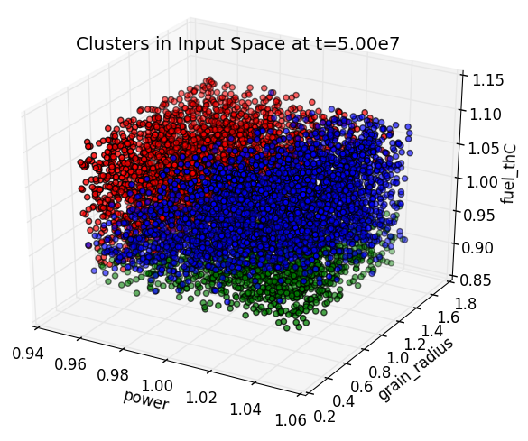
Time Dependent Clustering

Slide 31
RAVEN as a Framework: Plugins
RAVEN
Validation
CashFlow
LOGOS
HERON
CashFlow: financial package to do NPV, IRR, PI and other financial indexes for complex investment plans
HERON: capacity optimization and grid dispatch for stochastic multi-energy scenarios
LOGOS: integrate classical PRA analysis (SAPHIRE) with Dynamic-PRA (RAVEN) for financial optimization of maintenance
Validation: new plugin for general software validation
Modelica Ecosystem
Create your own!!!!!!!!!!

Slide 32
Summary of RAVEN capabilities
Stochastic Modeling
Perturbation/Exploration
Visualization
Loose model coupling
Analysis workflow templating
Static/Dynamic integration
Data Analysis
Knowledge Discover
Surrogate modeling
External Plug-Ins
Synthetic data generation

Slide 33
Thank you
Questions?
RAVEN: raven.inl.gov

Slide 34
Backup slides

Slide 35
Third Parties Investing
The one we are aware of…
EDF (D-PRA for MAAP)
Westinghouse (surrogate for fire PRA)
FpoliSolutions (probabilistic engine, surrogate aided)
North Carolina State University (IRP, COBRA-TF interface)
University of Illinois at Urbana-Champaign (depletion, Serpent Interface)
University of Rome (Fast reactor sensitivity UQ, Melcor interface)
Oregon State University (Economics Melcor interface)
Idaho State University (Code calibration, Neutrinos interface)
Institute Nuclear Safety System Inc. (PRA, D-PRA, data mining)

Slide 36
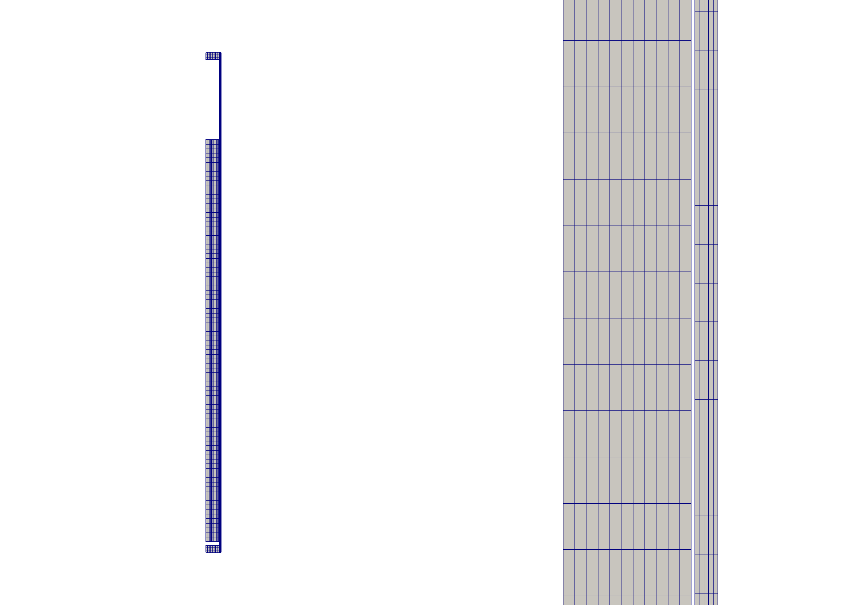
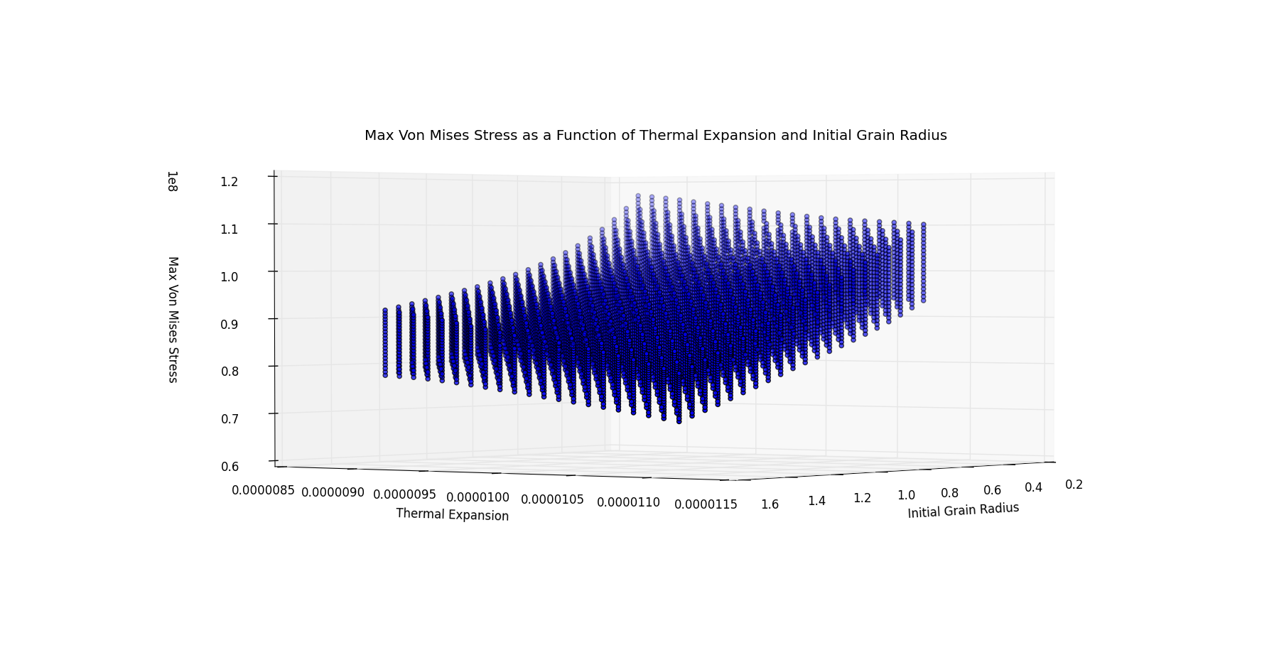
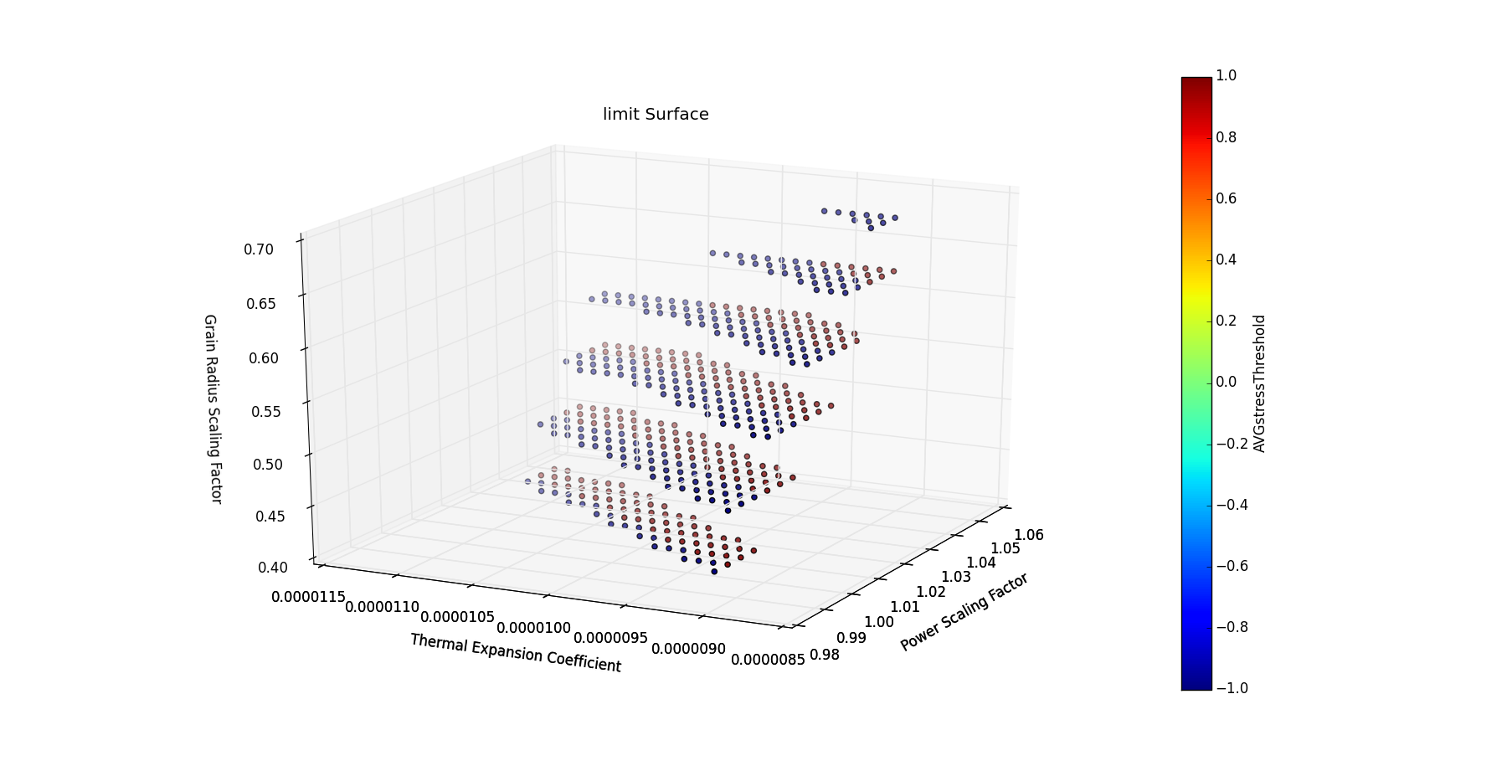
Limit Surface Applications:
Fuel Performance Code - BISON
Smeared pellet stack with hafnium insulator end pellets:
10 fuel pellets as a single, long pellet sandwiched between two insulator pellets.
10,000 second ramp from zero power to 25KW/m.
After the ramp the power was held constant to the end time of 1e8 seconds.
power scaling
factor
Notes:
Mesh:
The BISON mesh that was used was a smeared pellet stack with hafnium insulator end pellets. This stack simulated 10 fuel pellets as a single, long pellet sandwiched between two insulator pellets. The insulator pellets each consisted of 4 axial elements and 11 radial elements for a total of 44 elements. The fuel consisted of 80 axial element and 11 radial elements for a total of 880 elements. Lastly, the cladding consisted of 135 axial elements and 5 radial elements for a total of 670 elements. The complete mesh and a zoomed in view can be seen in Figure 1A and 1B, respectively.

Slide 37
Limit Surface Applications:
PWR SBO – RELAP-7
PWR SBO
100% Power
120% Power

Slide 38
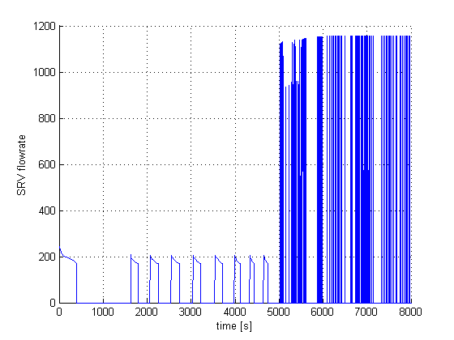
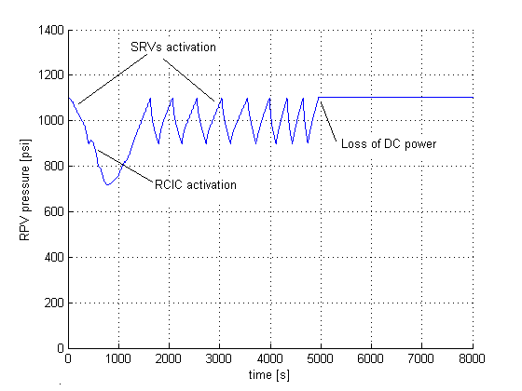
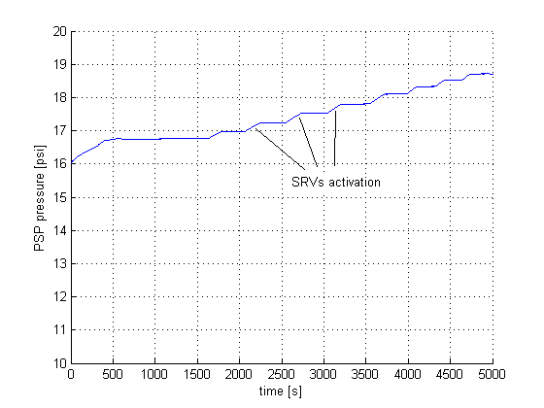
Limit Surface Applications:
BWR SBO – RELAP-5
100% Power
120% Power
Notes:
Scenario: LOOP + loss of DGs
3 recovery strategies: off-site power recovery, DG recovery, FW recovery
After loss of DGs, cooling is provided by RCIC/HPCI (mid figure); pressure control provided by SRV (left figure).
Torus pool temperature increases at each SRV activation (right figure).
When pool TH limits are reached, the RPV is depressurized; no cooling can be provided other than FW if available

Slide 39
Uncertainty Quantification
Demo: BWR Station Black Out analysis
Code: RELAP5-3D (10,000 runs)
Sampled variables:
Elapsed time before Diesel Generation loos
Diesel Down time
Power Level
Clad Temperature (system Output):
Entry | Monte Carlo
Mean: | 2.32E+03
Sigma: | 9.05E+02
Kurtosis: | -1.54E+00
Median: | 3.09E+03
Skewness: | -5.25E-01

Slide 40
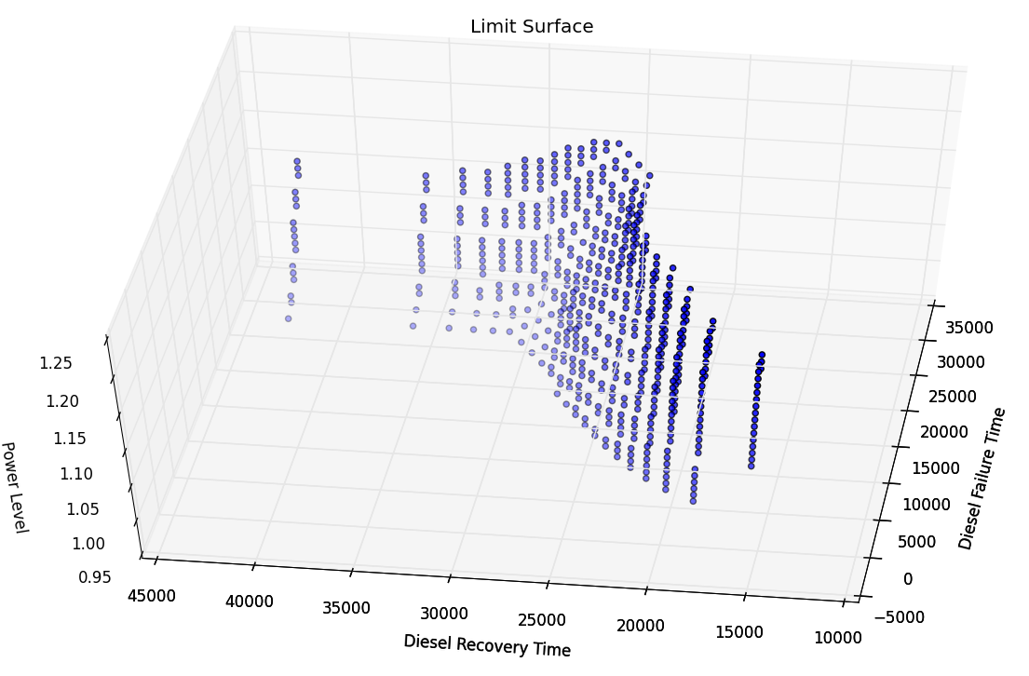
Risk Management: Reliability Surface
Safe Region
Failure Region
Seeking the combination of parameters (axis) that allows not to exceed the maximum clad temperature

Slide 41
Comparison vs ROM
Statistical figures for max clad temperature:
Entry | Original | Surrogate
Mean: | 2.3296E+03 | 2.3103E+03
Sigma: | 9.0559E+02 | 8.4599E+02
Kurtosis: | -1.547E+00 | -1.4497E+00
Median: | 3.092E+03 | 2.683E+03
Skewness: | -5.256E-01 | -5.0662E-01
Failure Pb | 60.99% | 60.82%
The matching of the results between the Monte Carlo Sampling on the RELAP5-3D code and the build surrogate confirm the good training set
New input distributions could be tested without re-running the original code but using the ROM

Slide 42
Multi-Unit Analysis: Plant Model
TH Modeling: 6 RELAP5-3D models
2 PWR at full power
1 PWR in mid-loop condition
3 SFPs
Top Event: clad temperature reaches 2200 F
No severe accident is modeled (i.e., level 1 PRA)
Large number of resources shared among units
AC systems among unit 1 and 2
Aux. feed-water cross-tie among unit 1 and 3
CST cross-tie among unit 2 and 3

Slide 43
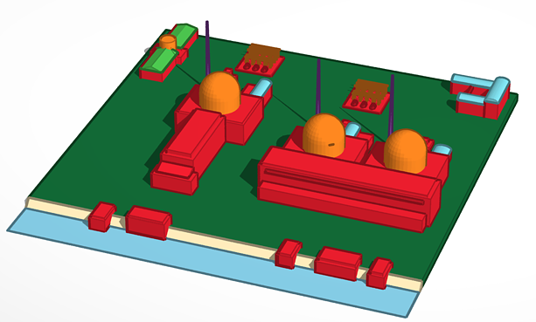
Ensemble model for Multi-Unit Power Plant: 1st Configuration
Dynamic PRA for a Station Black Out Multi-Unit scenario
RAVEN ensemble model
PWR1
Unit 1
SFP1
Plant Logic Model
PWR2
Unit 2
SFP2
PWR3
Unit 3
SFP3
Credits:
Diego Mandelli

Slide 44
Ensemble model for Multi-Unit Power Plant: 2nd Configuration
Exploiting the restart capability of the driven code, the EnsembleModel can be constructed through a chain of basic units that can be repeated, for example, over time
10 minutes
RAVEN ensemble model
RAVEN ensemble model
Unit 1
PWR1
Unit 1
PWR1
SFP1
Human Actions
SFP1
over time
Plant Logic Model
Unit 2
PWR2
Plant Logic Model
Unit 2
PWR2
SFP2
SFP2
Unit 3
PWR3
Unit 3
PWR3
SFP3
SFP3

Slide 45
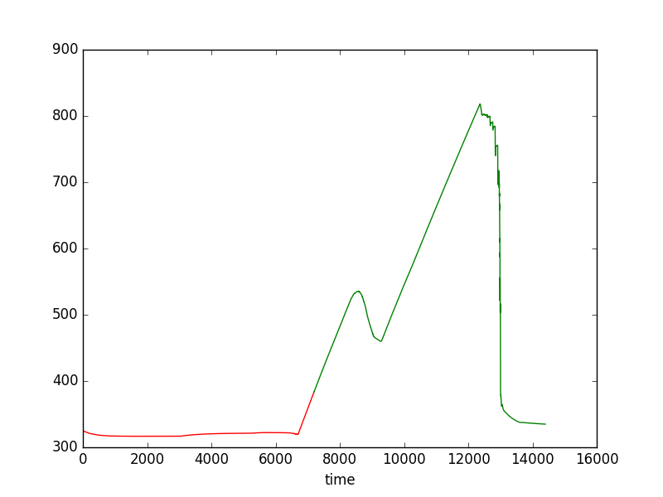
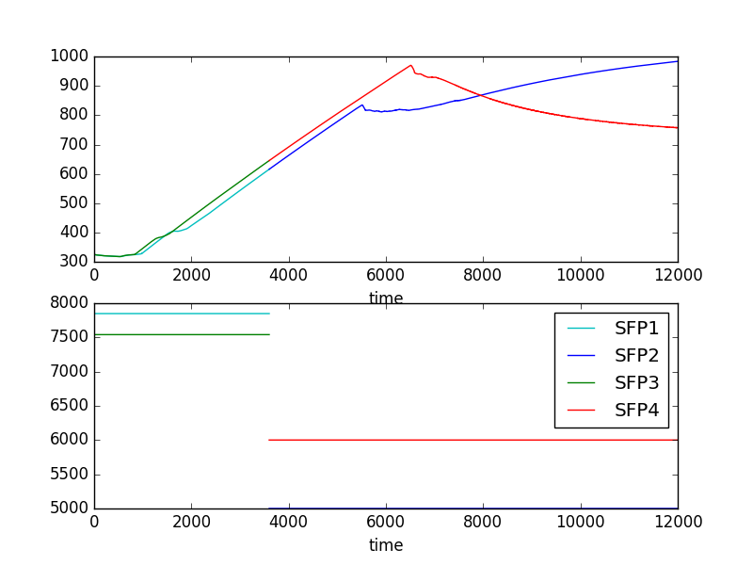
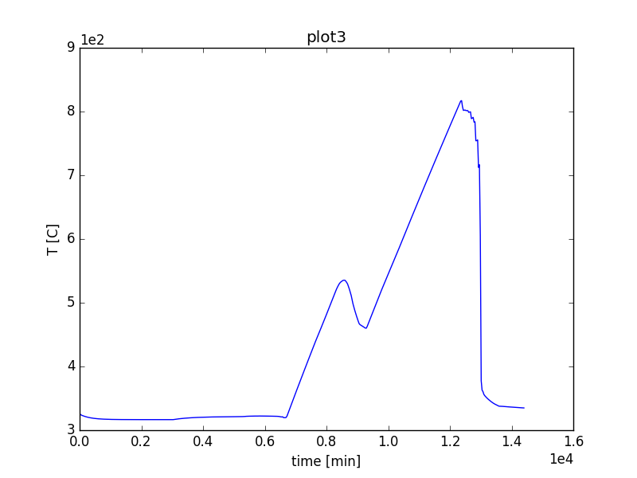
Ensemble model for Multi-Unit Power Plant: Example results
4 Spent Fuel Pools
Transferring Restarts

Slide 46
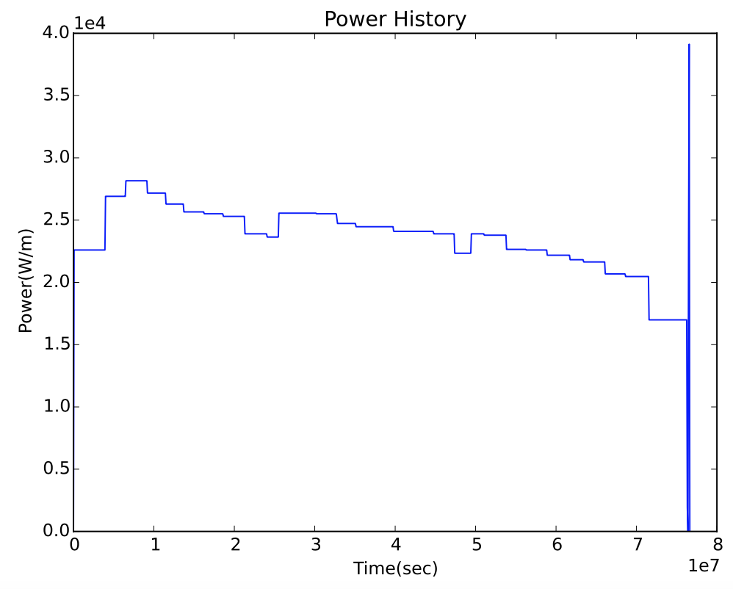
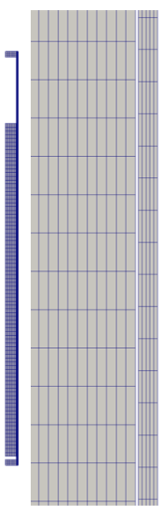
Uncertainty Quantification and Data Analysis using BISON/RAVEN
Axis-symmetric rodlet and composed of ten stacked UO2 pellets and surrounded by a zirconium alloy cladding
10 pellets are simulated as a single, long pellet sandwiched between two insulator pellets
Too much stress in the cladding can cause cracking and allow radioactive gas to leak into the plant environment
Code Variable Name | Meaning | Unit | Lower Bound | Upper Bound
Fuel_thE | Fuel thermal expansion | 1/K | 8.5e-6 | 1.15e-5
Clad_thE | Cladding thermal expansion | 1/K | 3.5e-6 | 6.5e-6
Clad_thC | Cladding thermal conductivity | W/(m K) | 14.4 | 17.6
Fuel_thC | Fuel thermal conductivity scaling factor | - | 0.9 | 1.1
Grain_diffCoeff | Inter-granular diffusion coefficient | - | 0.1 | 10.0
Power | Power scaling factor | - | 0.95 | 1.05
Fuel_reloc | Fuel relocation scaling factor | - | 0.8 | 1.2
Grain_radius | Grain radius scale factor | - | 0.4 | 1.6
Clad_ox | Oxide scale thickness scaling factor | - | 0.6 | 1.4
Clad_creeprate | Creep rate scaling factor | - | 0.7 | 1.3
Gas_thC | Gas thermal conductivity scaling factor | - | 0.9 | 1.1
Grain_res_param | Inter-granular resolution scale factor | - | 0.1 | 10.0
Notes:
In this simulation, the linear power is ramped up from 0 W/m to 25000 W/m over the first 10000 seconds of the simulation before leveling off. Note that the power_scalef will augment the final power in each simulation. The goal is to attain a better understanding of the contact that occurs when the fuel pellets expand to the point of touching the cladding. The stress on the cladding at t=0 is due to a compressive force from the water pressure outside of the cladding. As fission occurs, the fuel rod expands as it is heated due to thermal expansion and swelling from the release of fission gas within the microstructure of the fuel. These same factors cause a force that counteracts the compressive force from the external water pressure, therefore the stress in the cladding decreases for a time until these forces reach equilibrium. After the equilibrium point, the expansive forces on the cladding begin to dominate, thus causing more stress on the cladding as it expands.

Slide 47
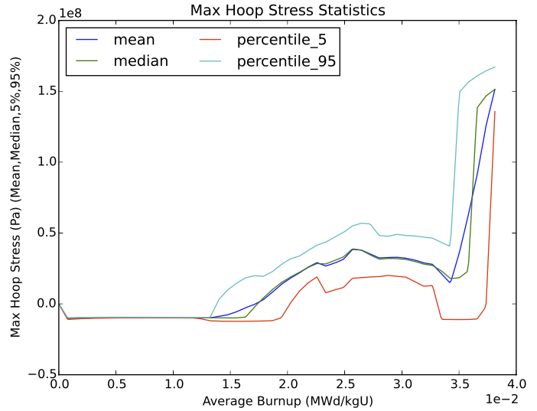
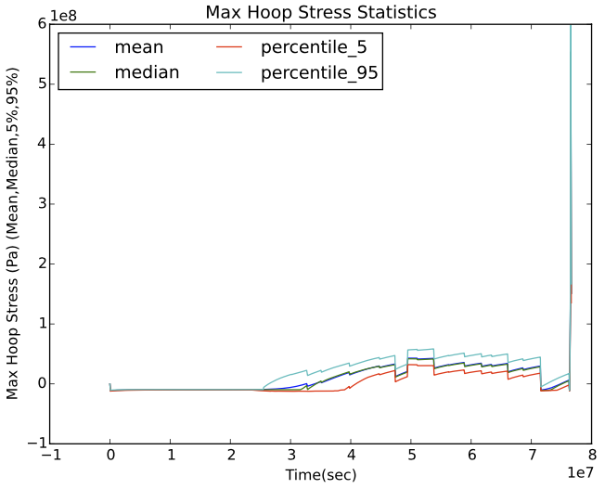
Time Dependent Statistics
hoop stress initiate the inversion of sign (from negative to positive)
Notes:
The use of burnup as a pivot variable, it compresses not relevant part of the experiment and expand the plots in correspondence of the region of interesting transient in the fuel behavior

Slide 48
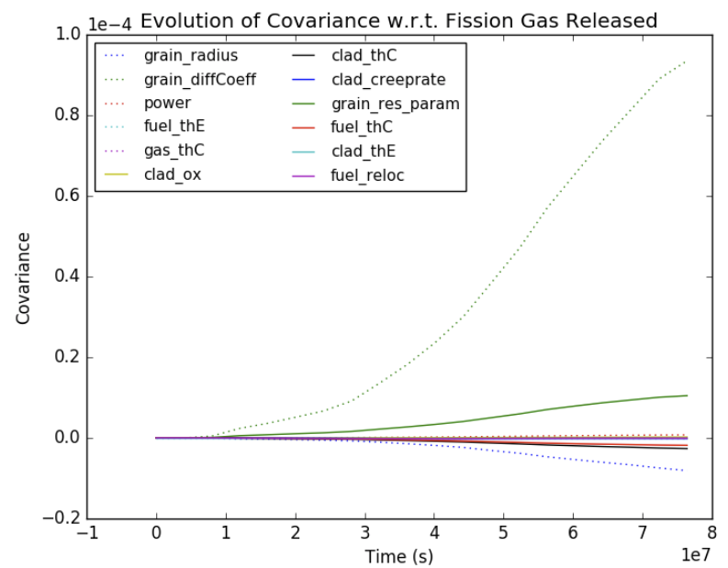
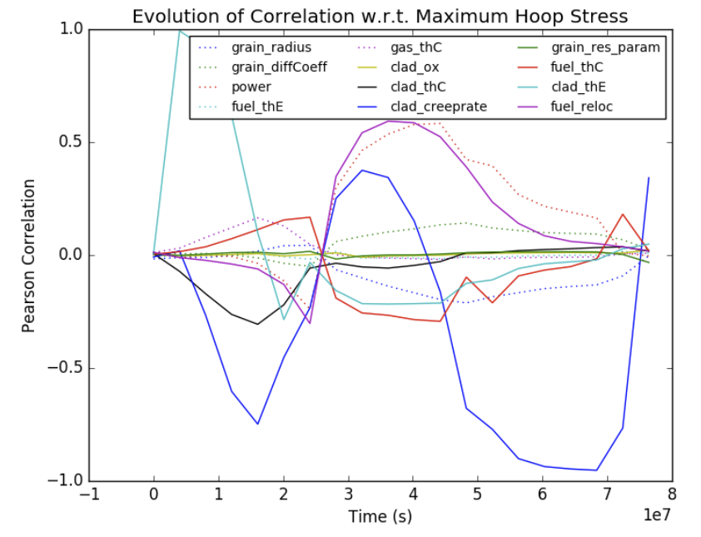
Time Dependent Relational Analysis
Notes:
The grain diffusion coefficient is the largest positive contributor; among the other positive contributors we have the inter-granular resolution scale factor, and power. The transition spots identified by the dispersion analysis due to the clad fuel contact appear clearly at around ~3.3 1.e7 sec in the maximum hoop stress plots. The larges negative contributor is the grain radius followed by the thermal conductivity of the clad and fuel.

